Slide 1
Thembela
My dream is to be a police man

Slide 2
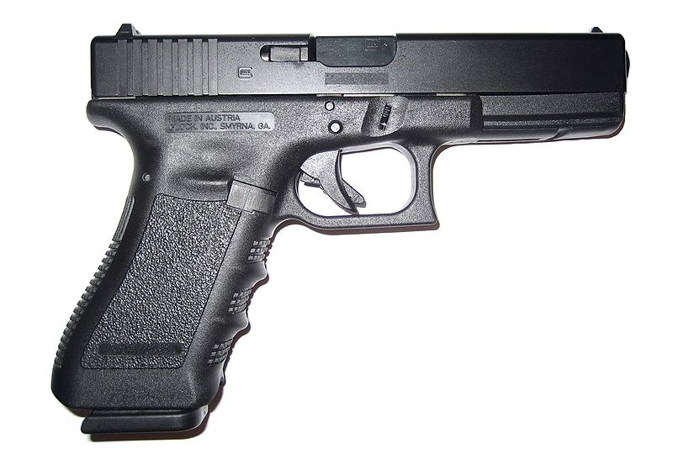
I know police they use guns

Slide 3
It is important to be a police man because they care

Slide 4
Police man make R13000 a month

Slide 5
There are six colleges in all and you have six months of training

Slide 6
South african police officers on duty genorally carry 889mm pistol

Slide 7
Police officers wear a light blue uniform

Slide 8
Police man help protect people

Slide 9
I still want to know about saftey

