Slide 1
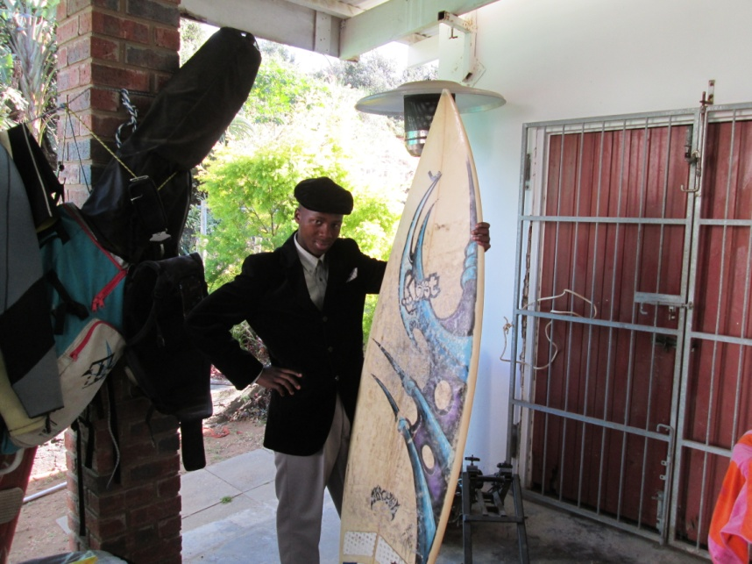
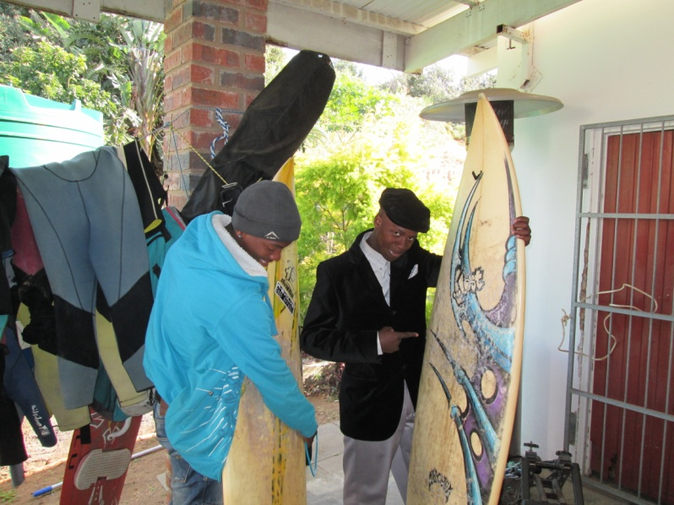
SANDILE PAKAMILE
Notes:
I live in Cintsa East
And am 18 years-old.
I am a Surfer

Slide 2
I WANT TO BE A SURFER

Slide 3
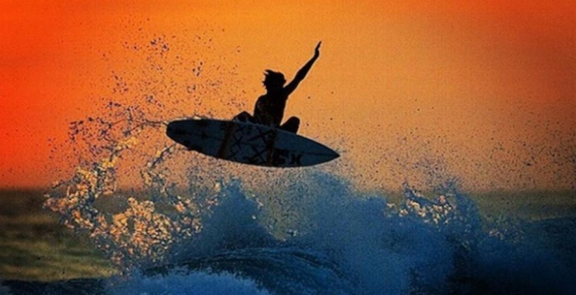
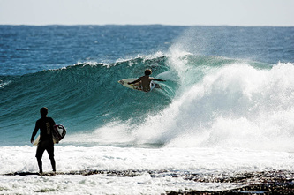
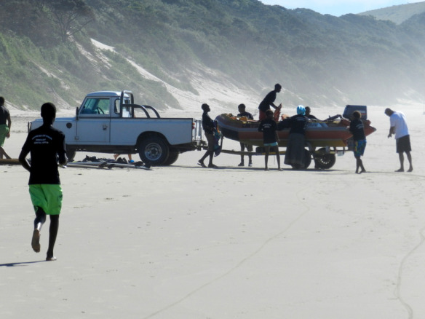
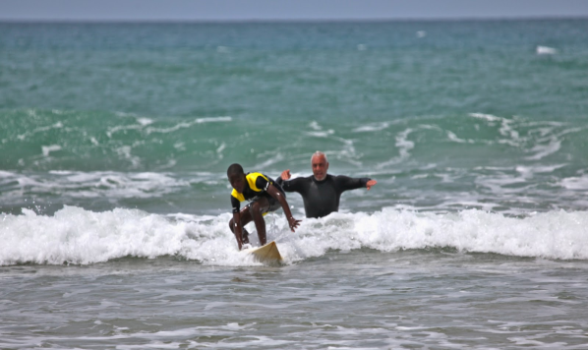
MY LOVE FOR SURFING

Slide 4
SALARYS

Slide 5
MY BEST BOARD ON A CONTEST

Slide 6
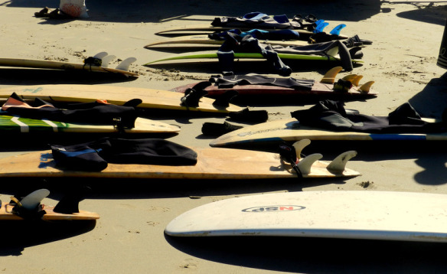
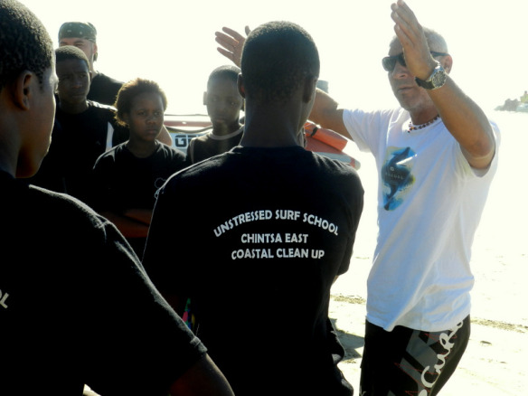
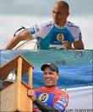
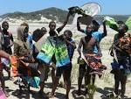
THE WAY I GET SPONSOR’S

Slide 7
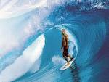
MY ROLE MODEL
Notes:
I want to be like Kelly Slater cause he is a hero on surfing

Slide 8
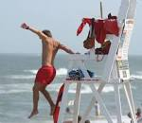
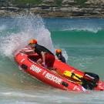
OTHER THING I WANT TO be

