Slide 1

Becoming a pilot
By tito
Notes:
Lil Wayne- Love Me or Hate Me

Slide 2
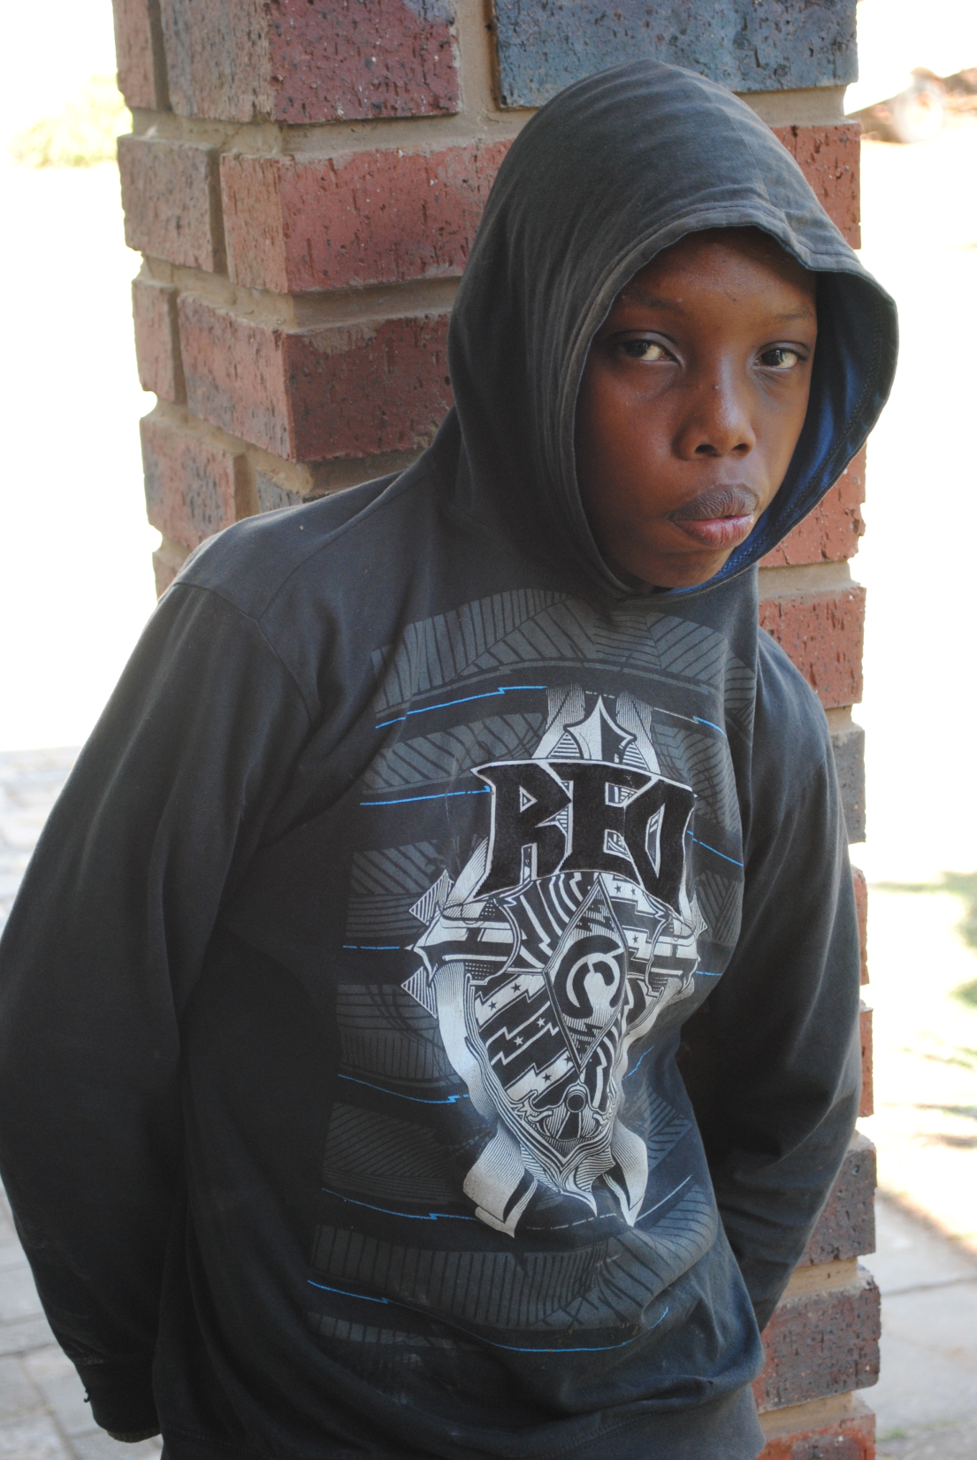
Notes:
My name is Tito and I want to be a pilot because I want to travel the world.

Slide 3
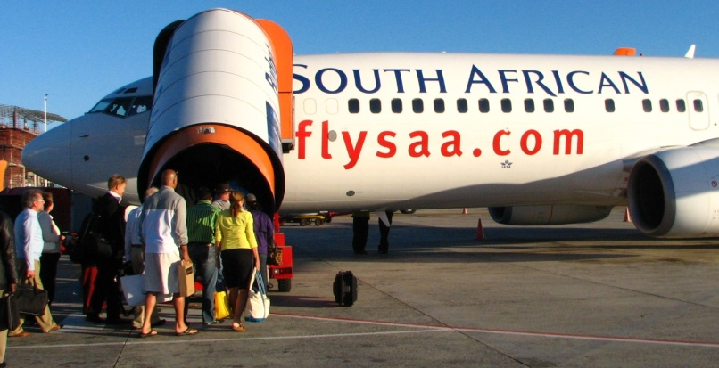
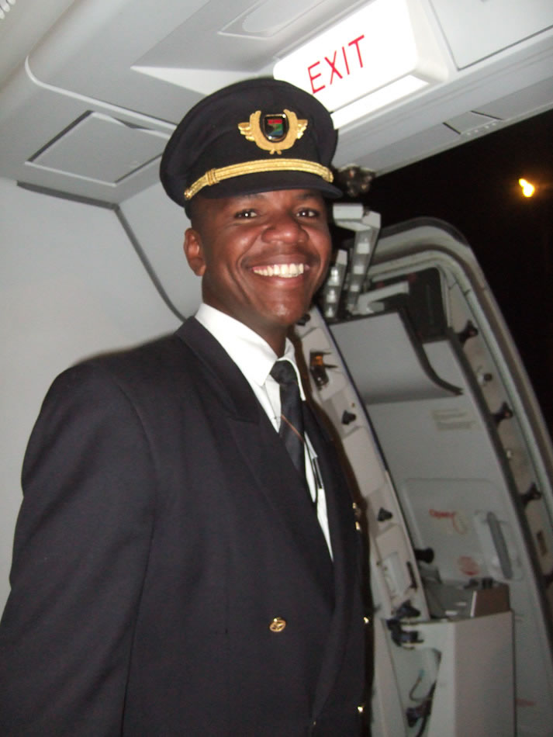
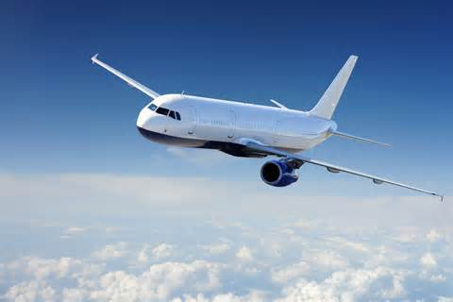
Notes:
Pilots travel the world with people. Sometimes they travel with famous people.

Slide 4
Where to find a job when you finish training?
How long does training take?
Who will train me to become a pilot?
Notes:
Even though I know a little about what it takes to become a pilot, I still have lots to learn. My biggest questions are: Where to find a job when you finish training? How long does training take? Who will train me to become a pilot?

Slide 5
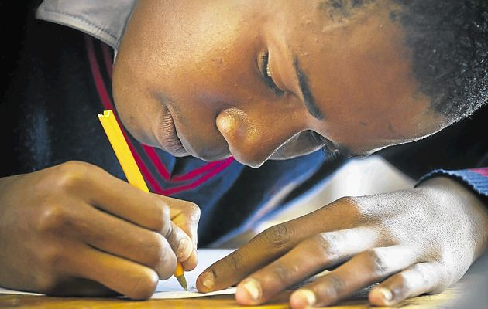
Notes:
In order to become a pilot, you need to pass grade 12, English, mathematics and physical science.

Slide 6
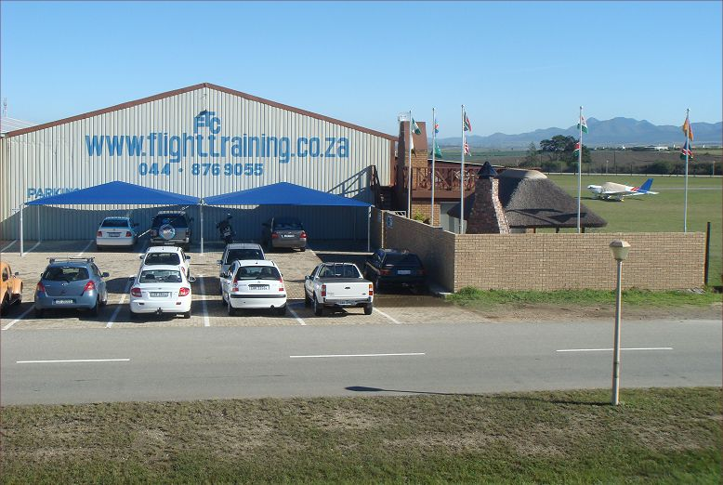
Notes:
One place you can train to become a pilot is the South African Flight Training Academy near Johannesburg. The training takes 10 to 12 months.

Slide 7
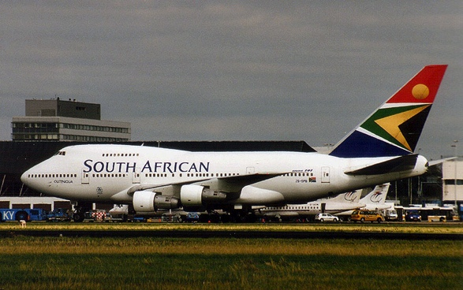
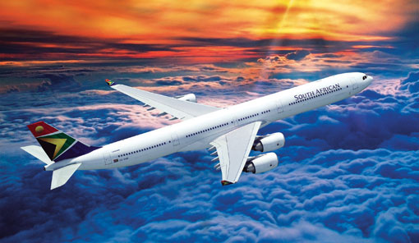
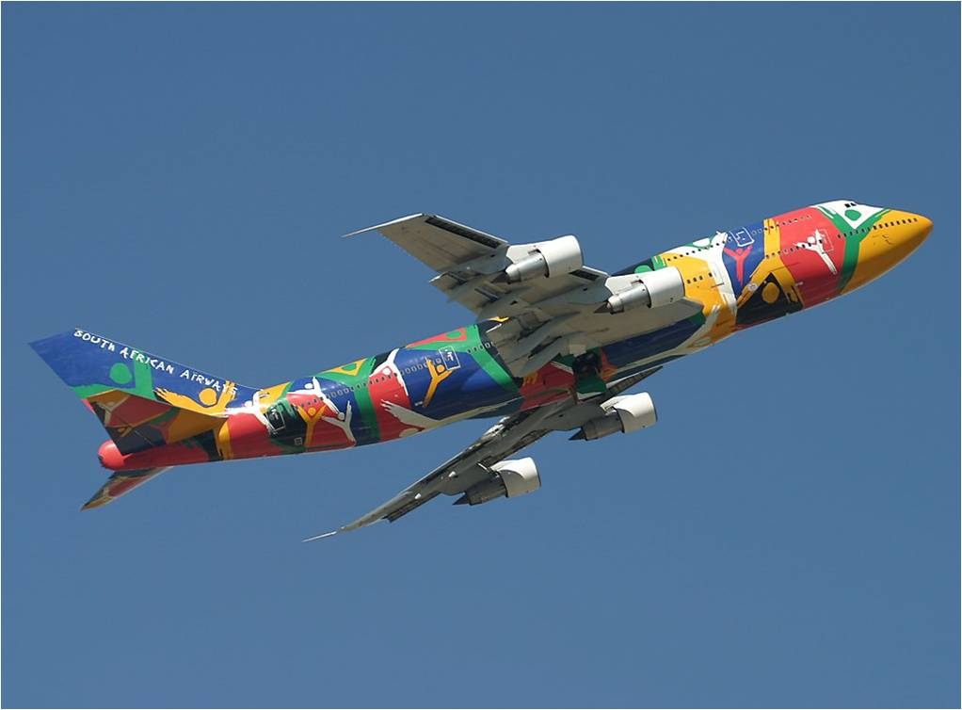
Notes:
When I finish, I want to work for South African Airways. This is one of the places you can work as a pilot.

Slide 8
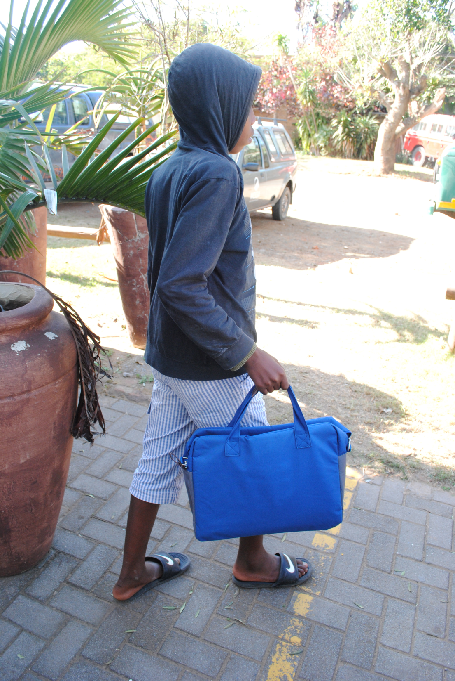
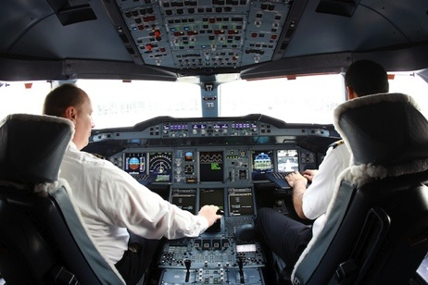
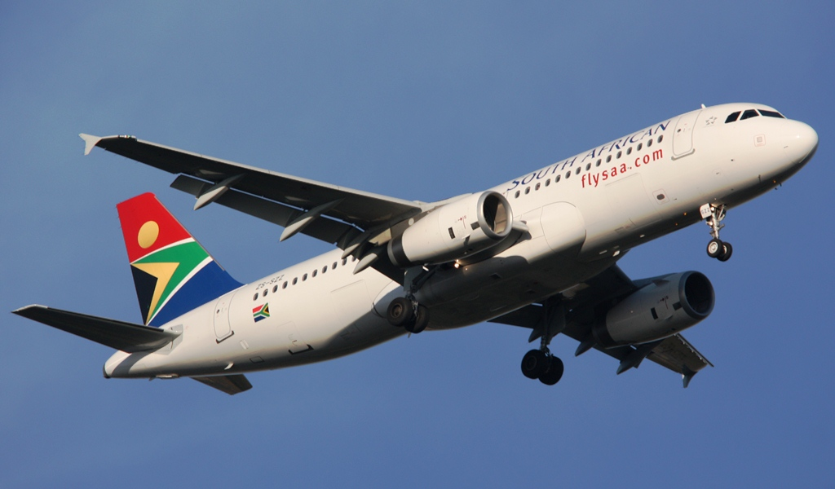
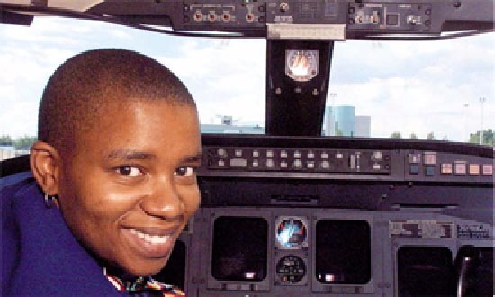
Notes:
To reach my dream of becoming a pilot, I have to work hard and do good at school. In time, I know I can do this because becoming a pilot is my dream.

